Slide 1
Introduction lesson
1
Greetings, ask & answer personal questions, use modal verbs for rules, identify different classroom stationery.
"What's your name", "My name is...", " Where are you from?", "What pet do you have?", "What is your favorite food/drink/color?"
pet, food, drink, color, brother, sister, can, can't, must, mustn’t, bag, pen, pencil, eraser, crayon, ruler, stapler, glue, marker, scissors.
None for this lesson
Class survey intros worksheet
Classroom objects worksheet
name tags for each student
a small ball
poster paper (one sheet per group of 4-6)
colored marker pens
classroom stationery: pen, pencil, eraser, crayon, ruler, stapler, glue, marker, scissors
board with markers / chalk
This lesson provides a good platform to begin the course with your 7-9 year olds as it provides an opportunity for everyone to get to know each other and also sets the ground rules for behavior within the classroom. 'Wh’ question forms, modal verbs for rules and stationery vocabulary will also be practiced.

Slide 2
Media in these slides
Interactive activities
Vocabulary
Readers / Songs
Printables
Play games and activities on these slides with your class
View lesson vocabulary images on screen
Read stories and play songs on these slides
View worksheets and other printables on these slides
"Ask me" activity
Write about yourself
Classroom rules
Classroom rules example ideas
Stationery vocab: pen, pencil, eraser, crayon, ruler, stapler, glue, marker, scissors
Class survey intros worksheet
Classroom objects worksheet

Slide 3
Hello!
- Introduction lesson -

Slide 4
Where are you from?
Click to see
Hometown
How old are you?
Click to see
Age
What is your favorite drink?
Click to see
Have you finished this activity? If so, press space.
To go back to the activity, press left arrow key (◄ ).
Drink
What pets do you have?
Click to see
SAMPLE FOR EVALUATION
Join ESL KidStuff
to view without watermark.
Pets
What is your favorite color?
Click to see
Color
What is your favorite food?
Click to see
How many brothers and sisters do you have?
Food
Click to see
Brothers / Sisters
What is your name?
Click to see
Click to reset
Name
Ask me

Slide 5





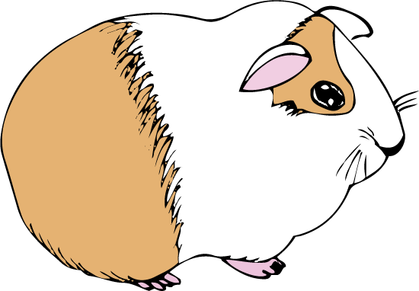


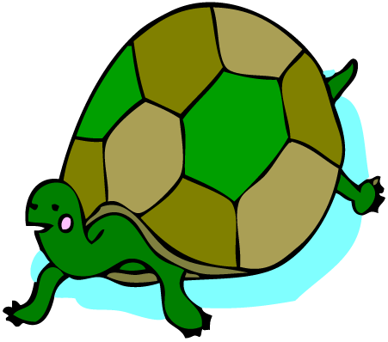
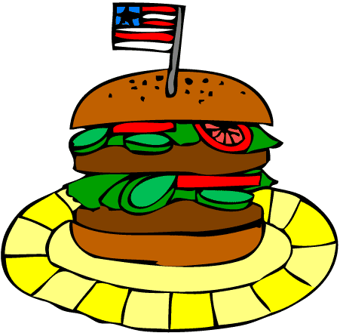
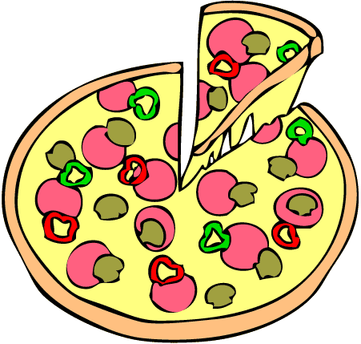

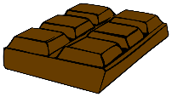

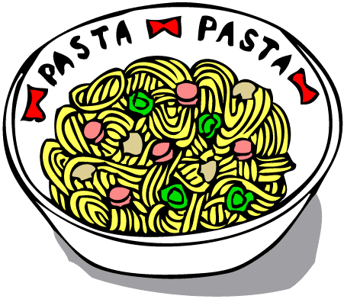













Ideas
Pets
dog
cat
bird
fish
hamster
guinea pig
mouse
rabbit
turtle
Food
SAMPLE FOR EVALUATION
Join ESL KidStuff
to view without watermark.
hotdog
hamburger
pizza
chicken
chocolate
egg
pasta
cake
sushi
ice-cream
Drink
juice
water
milk
soda
milkshake
tea
coffee
ice tea
ice coffee
Colors
red
yellow
pink
green
purple
orange
blue
brown
black
white
Write about yourself

Slide 6
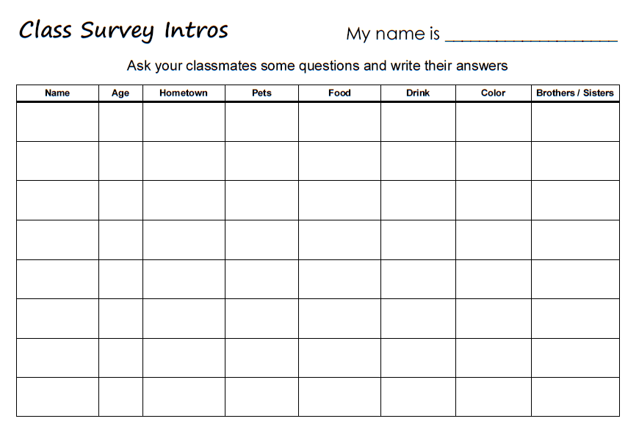
SAMPLE FOR EVALUATION
Join ESL KidStuff
to view without watermark.
Class survey

Slide 7




Our classroom rules
We can
We can’t
We must
We mustn’t
ask our teacher questions.
talk while our teacher is talking.
do our homework.
take things without asking.
SAMPLE FOR EVALUATION
Join ESL KidStuff
to view without watermark.
[ Press space to see example ideas ]
Rules poster

Slide 8
Our classroom rules
We can
We can’t
We must
We mustn’t
ask our teacher questions.
talk while our teacher is talking.
do our homework.
take things without asking.
respect each other.
fight, hit or kick anyone.
use my language when talking to the teacher.
turn off our phones.
SAMPLE FOR EVALUATION
Join ESL KidStuff
to view without watermark.
bring any electronic devices to class (e.g. games).
talk to others in English.
bring our books, folders, pens, etc. to every class.
bring food or drinks into class.
stay in our seat.
treat others badly.
raise our hand to answer questions.
start packing up before the teacher tells us to.
help other students.
be rude to anyone.
be in the classroom on time.
Rules poster example ideas
[ Press space to see more example ideas ]

Slide 9






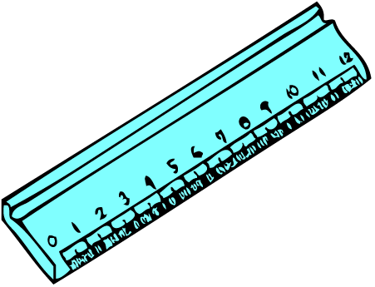



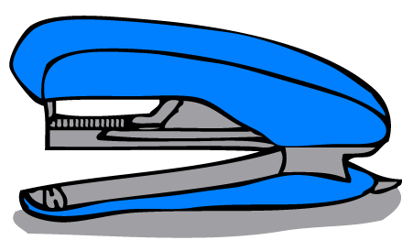
pen
pencil
eraser
crayon
ruler
SAMPLE FOR EVALUATION
Join ESL KidStuff
to view without watermark.
scissors
stapler
glue
marker
Stationery vocab
8 | © ESLKidStuff.com

Slide 10
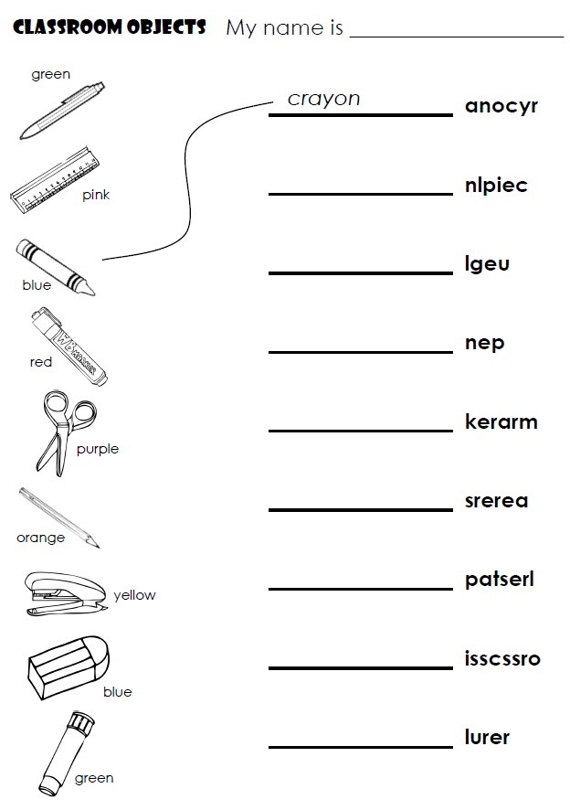
SAMPLE FOR EVALUATION
Join ESL KidStuff
to view without watermark.
Homework
9 | © ESLKidStuff.com

Slide 11

The end
Thank you!
SAMPLE FOR EVALUATION
Join ESL KidStuff
to view without watermark.

