Slide 1
Colors and fruit 3
4
Identify and recognize 7 colors and 6 fruit.
"What color is it?“, "What fruit is it?"
orange, melon, pineapple, balloon.
red, blue, green, purple, yellow, pink, orange, apple, banana, grapes.
Hello Song (audio & video)
Goodbye Song (audio & video)
The Rainbow Song (audio & video)
What color am I? reader (video)
Fruit flashcards (apple, banana, grapes, orange, melon, pineapple)
Color the 6 fruit worksheet
The Rainbow Song song sheet
What color am I? classroom reader
What color am I? reader worksheet
name tracing sheets (one for each student with their name in dots)
colored crayons / pencils
name tags for each student
a glove puppet
7 sheets of origami colored paper (red, green, blue, purple, yellow, pink, orange)
7 balloons of different colors (red, green, blue, purple, yellow, pink, orange)
plastic fruit (in a small box)
a length of rope
cushions (1 per student)
A fun lesson with lots of activities building on the previous lessons - and also your students’ first classroom reader!

Slide 2
What color?
- Colors and fruit 3 -

Slide 3
Warm up and
Maintenance
SAMPLE FOR EVALUATION
Join ESL KidStuff
to view without watermark.
Greetings
Name tags
Glove puppet greetings
Sing “The Hello Song”
Name writing
Homework check
Do “Exercise routine” activity
Review colors: red, blue, green, purple, yellow, pink, orange
Play “Color pass”, “Color touch” and “Color hold up”
Play "Balloon kick"
Sing “The Rainbow Song”
[ Press space bar or left-mouse click to move through the slides ]

Slide 4
Teacher’s notes are here on every lesson slide.
Greetings
Greet the students by name as they enter the classroom and gesture for them to sit down (on cushions if you have them) in a fan-shape around you.
1
Hello!
SAMPLE FOR EVALUATION
Join ESL KidStuff
to view without watermark.
Let’s sit down
[ Press space bar or left-mouse click to move to the next slide ]

Slide 5
Name tags
Before class prepare some name tags (stickers or pin-on tags) with each student's name written on in lower case letters.
Sit down with your students and lay out the name tags in front of you. Pick up each tag and call out the name.
Try and encourage each student to put their hand up and say "yes". Hand over the tags and help to pin / stick on.
In later lessons, once your students can recognize their written name, you can have them pick out their own name tags.
2
SAMPLE FOR EVALUATION
Join ESL KidStuff
to view without watermark.
Name tags
[ Press space bar or left-mouse click to move to the next slide ]

Slide 6
Glove puppet greetings
Bring out your glove puppet bag and have everyone shout "Hello!“ into the bag until he wakes up and jumps out of the bag.
Then model talking to the glove puppet …
"Hello", What's your name?"
Puppet: "My name is...".
… and then have the puppet say hello to each student and ask them the same questions.
Finally, go around saying "Goodbye" and "See you" before going back into the bag and back to sleep.
3
SAMPLE FOR EVALUATION
Join ESL KidStuff
to view without watermark.
Glove puppet
[ Press space bar or left-mouse click to move to the next slide ]

Slide 7


Sing “The Hello Song“
Sit in a circle and listen to the song (clap along or pat knees).
Play it once more emphasizing "Hello". Your students will pick up the words surprisingly quickly.
Gestures
The first time you play the song do the gestures and encourage everyone to do them with you.
Wave as you sing the "Hello, hello" parts.
Gesture to others as you sing "How are you today?“
Point to yourself as you sing "I’m fine, thank you“
Hand gesture towards another student as you sing "And how about you?"
The Hello Song
3
Song audio and video
only available to ESL KidStuff members.
Click here to remove message.
Song audio and video
only available to ESL KidStuff members.
Click here to remove message.
SAMPLE FOR EVALUATION
Join ESL KidStuff
to view without watermark.
Click to play song
Play song audio
Play song video

Slide 8
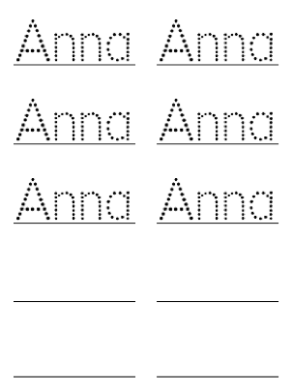
Name writing
Before class prepare a writing sheet for each student with their name written in dots for them to practice tracing.
Everyone sits at a table with you. Take the sheets of paper and read the names - encourage each student to put their hand up and say "Yes". Give out the sheets to each student.
Next, say, "Take out your crayons" and have everyone trace their name using different colors. As the students trace their names, circulate, help and give lots of praise. Be sure to elicit red, blue and green colors as a review from last class.
Finally, praise and reward students for doing a good job!
5
SAMPLE FOR EVALUATION
Join ESL KidStuff
to view without watermark.
Name writing practice
[ Press space bar or left-mouse click to move to the next slide ]

Slide 9
Homework check
Check each student's homework that you set in the last lesson.
Ask each student some questions about their homework worksheet (e.g. "what color is this cup cake?"), give lots of praise, and then put some kind of mark on the homework sheet (e.g. a sticker, a stamp or draw a smiley face).
Finally, tell your students to put their homework back into their bags.
6
SAMPLE FOR EVALUATION
Join ESL KidStuff
to view without watermark.
Homework check
[ Press space bar or left-mouse click to move to the next slide ]

Slide 10
Do "Exercise routine" activity
Time for some action. Say the following and have the students follow your lead:
"Stand up (T stands and so does everyone else)
"Hands up / hands down" (do 4 or 5 times)
"Jump" (4 or 5 times)
"Run! / Stop!" (4 or 5 times)
"Turn around! / Stop!" (4 or 5 times)
finally "Sit down".
7
hands up
hands down
jump
stand up
SAMPLE FOR EVALUATION
Join ESL KidStuff
to view without watermark.
sit
down
Press space or
left mouse click to see exercises
run
turn around
Exercises
[ Press space bar or left-mouse click to move to the next slide ]

Slide 11
Review colors: red, blue, green, purple, yellow, pink, orange
Use the colored origami paper / paper / card from the previous lesson.
Sit everyone in a circle and hold up the first colored paper and elicit the color (e.g. red). Chorus and practice saying the color. Do this for the rest of the colors.
8
SAMPLE FOR EVALUATION
Join ESL KidStuff
to view without watermark.
Colors
[ Press space bar or left-mouse click to move to the next slide ]

Slide 12
Play "Color pass“
Take each color card and pass it to your nearest student. Say "red" as you pass red, etc. The students pass the colors round the circle.
Play "Color touch“
Next, lay the 7 colors in the middle of the circle. Say "Hands up". Students raise their hands. Then say "Touch.....red!" and the students should all try and touch the red colored paper. Do for all of the colors.
Play "Color hold up“
Finally, give each student one of the colored papers. Say "Hold up....blue!" - the students holding the blue papers raise them into the air.
9
SAMPLE FOR EVALUATION
Join ESL KidStuff
to view without watermark.
Play color games
[ Press space bar or left-mouse click to move to the next slide ]

Slide 13
Play "Balloon kick"
You need 7 balloons – one for each of the review colors – don’t blow them up yet.
Take one balloon and elicit the color. Then chorus "(blue) balloon" x3.
Now blow up the balloon (kids love watching this) and tie the end. Pat the balloon to one student and encourage him/her to say its color as they catch it. Let the student pat it back to you and repeat the color with all students. Do the same for the other 6 balloons.
Finally, line the balloons up and model the activity: "Ok, (your name) kick the (blue) balloon!", then run up to the (blue) balloon and kick it. Now instruct one student to kick a balloon, give lots of help and encouragement and then do with all the other students.
10
SAMPLE FOR EVALUATION
Join ESL KidStuff
to view without watermark.
Kick the balloons
[ Press space bar or left-mouse click to move to the next slide ]

Slide 14
Sing “The Rainbow Song”
For this song you can either use the colors on this slide as you all sing along or have students touch the 7 colors (e.g. colored paper, pencils, etc.) in front of him/her as they sing along.
… click panel for more »
Gestures
There are a number of activities you can do as you sing along to the song:
Give out the 7 colors to students (colored paper, origami paper, colored blocks, colored pencils – anything will do) and have students touch the colors in time with the song.
Simply pat your knees or clap in time with the music as you sing the song
Give each student a print out of the Rainbow Song song poster. As they sing along, they touch each color or picture.
Put colored paper up around the walls of the classroom. Have all of your students point to each color as it is sung.
… click panel to go back »
The Rainbow Song
11
Song audio and video
only available to ESL KidStuff members.
Click here to remove message.
Song audio and video
only available to ESL KidStuff members.
Click here to remove message.
SAMPLE FOR EVALUATION
Join ESL KidStuff
to view without watermark.
Click to play song
Play song audio
Play song video

Slide 15
New Learning and Practice
SAMPLE FOR EVALUATION
Join ESL KidStuff
to view without watermark.
Review and teach fruit: apple, banana, grapes, orange, melon, pineapple
Play "Fruit fetch"
Play "Fruit rope jump" game
5-minute play time
Do review quiz: colors and fruit
Read classroom reader "What color am I?"
[ Press space bar or left-mouse click to move through the slides ]

Slide 16
Review and teach fruit: apple, banana, grapes, orange, melon, pineapple
Use the plastic fruit from the previous lesson.
Sit everyone in a circle around you. Take out the box with the fruit in and shake it – the rattling sound will instantly alert your students.
Open the box and pull out a fruit. Ask "What’s this?" Elicit/Teach the word and chorus x3.
Next, mime biting the fruit and chewing, and then say "Yummy!". Then hold the fruit in front of each student to let them take an imaginary bite.
Encourage them to say "yummy!" or even "yuk!". Repeat with the other fruit.
1
SAMPLE FOR EVALUATION
Join ESL KidStuff
to view without watermark.
3 more fruit
[ Press space bar or left-mouse click to move to the next slide ]

Slide 17
Play "Fruit fetch"
You’ll need enough plastic fruit pieces for each student (e.g. if you have 12 students, you’ll need two of each plastic fruit – if you don’t have enough plastic fruit use our fruit flashcards instead).
Have your students sit on the floor. Throw the fruit around the classroom.
Model the activity: say,
"(Your name) give me a (red apple)".
Get up, find the fruit and put it into the box.
Now hold the box and instruct a student to pick up a fruit, bring it back to you and put it in the box.
Do for each student in the class so that all of the fruit has been collected. Repeat for fun.
2
SAMPLE FOR EVALUATION
Join ESL KidStuff
to view without watermark.
Play “Fruit fetch”
[ Press space bar or left-mouse click to move to the next slide ]

Slide 18
Play "Fruit rope jump" game
Take a length of rope and lay it across the floor at one end of the classroom.
On one side place the 6 plastic fruit and the box.
Have your students line up on the other side of the rope. Model: "(Your name), put the (apple) in the box". Run up to the rope, jump over the rope (say "Jump!") select the correct fruit and put it in the box.
Now instruct each student to do the activity.
3
SAMPLE FOR EVALUATION
Join ESL KidStuff
to view without watermark.
Fruit rope jump
[ Press space bar or left-mouse click to move to the next slide ]

Slide 19

5-minute play time
This is an optional segment that can be part of all your lessons at this level.
Allow your students to play with any games or toys you have.
If possible, use large tubs or boxes to hold the toys and bring them out for a few minutes each lesson. Tubs filled with animals, plastic fruit, building blocks, kitchen sets, plastic food, cars & vehicles, Mr. Potato Head dolls and so on.
Encourage your students to ask you for the toy they want to play with, circulate during the play time and ask students about their toys.
It’s also a good opportunity for a quick rest room break!
4
Play time!
SAMPLE FOR EVALUATION
Join ESL KidStuff
to view without watermark.
chat
games
rest room
toys
[ Press space bar or left-mouse click to move to the next slide ]

Slide 20





Do review quiz: colors and fruit
Bring everyone’s attention to this slide. You are going to show each image and your students will say the word!
First explain that they mustn’t shout out the answer – they must raise their hands. First student to raise a hand gets to answer.
Give lots of praise for correct answers!
5
Quiz time!
Press ► to start and move through the images,
press ◄ to go back.
Ready? Let’s start! ►
Good job!
The quiz is finished.
Press ◄ to go back.
Press space to continue to next slide.
SAMPLE FOR EVALUATION
Join ESL KidStuff
to view without watermark.
Click object to hear vocab
Review quiz
[ Press space bar or left-mouse click to move to the next slide ]

Slide 21
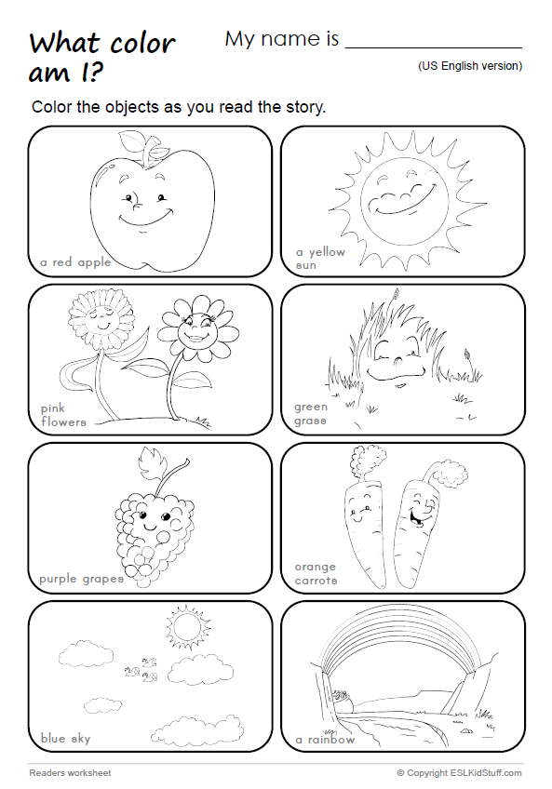
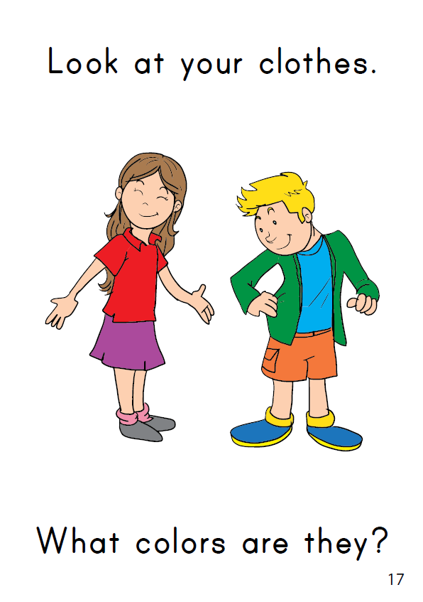
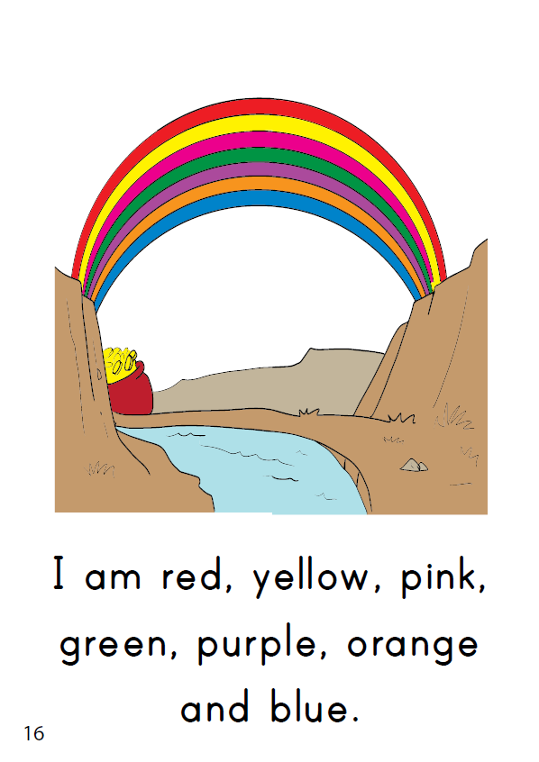
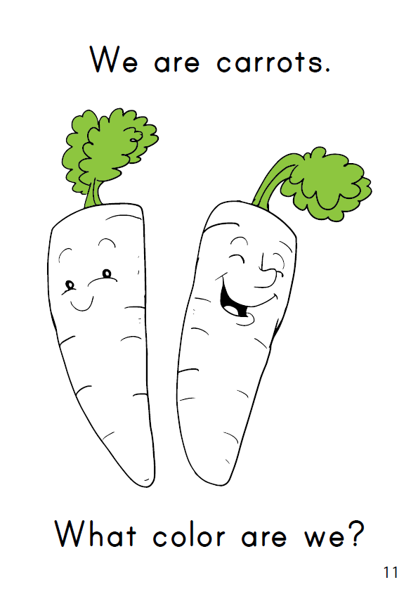
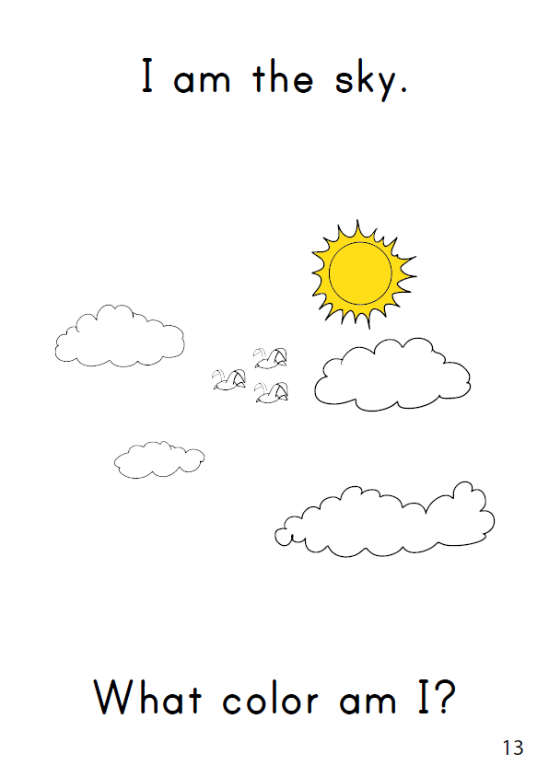
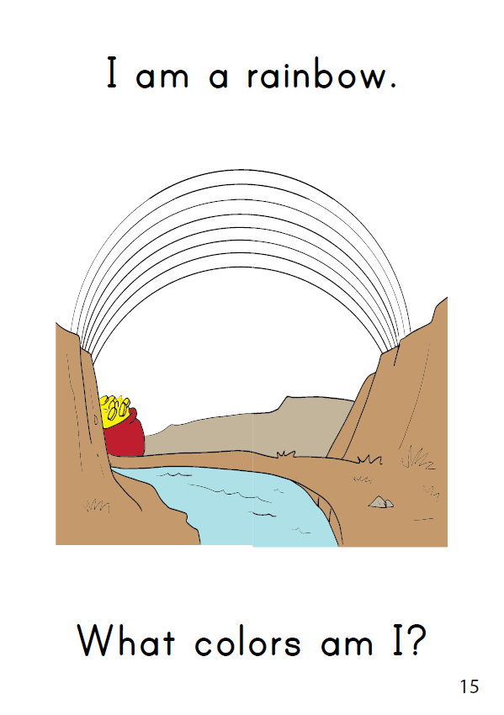
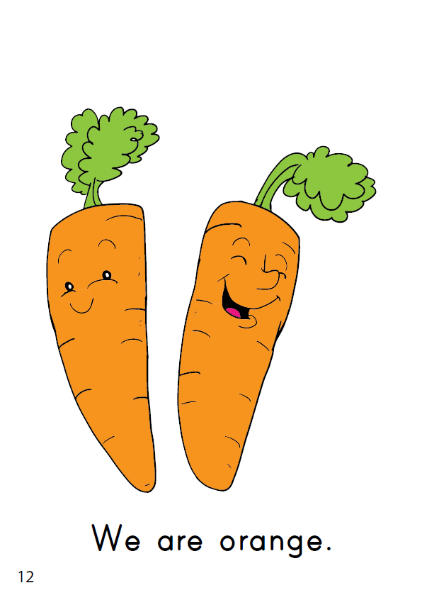
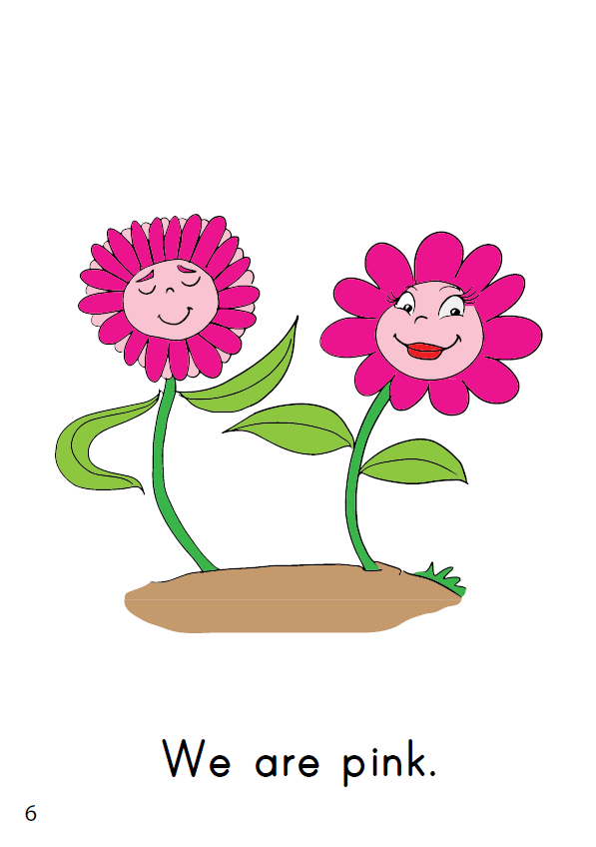
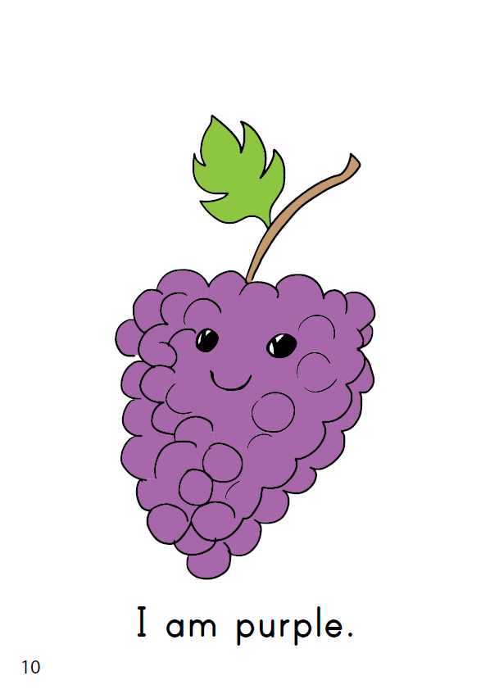
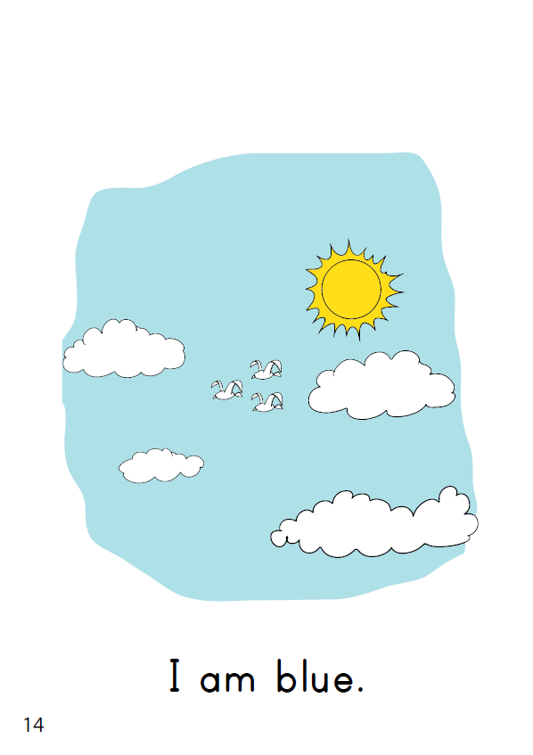
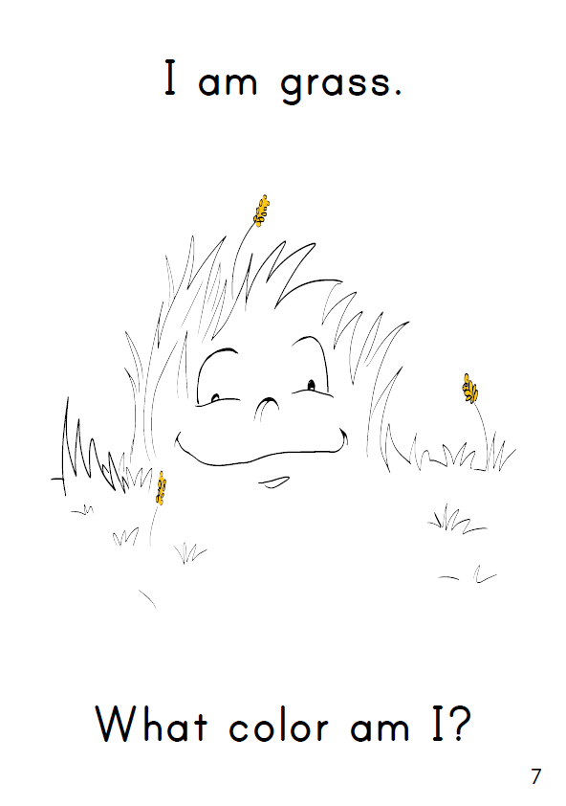
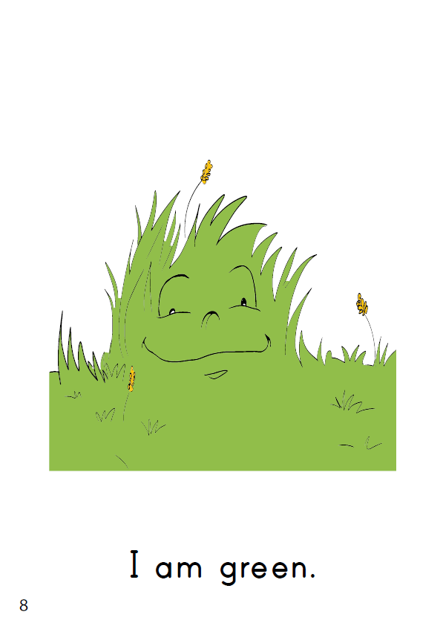
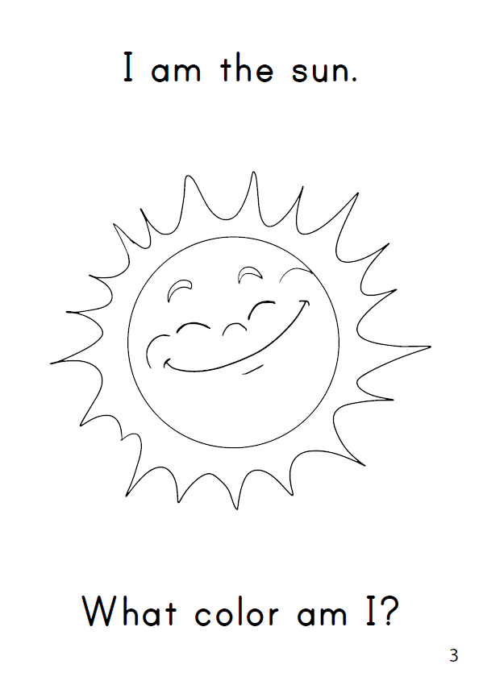

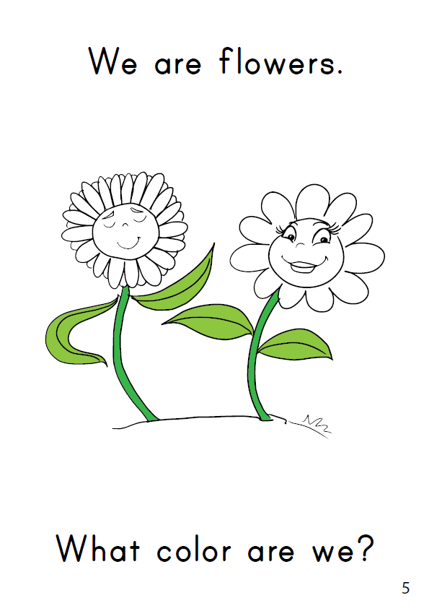
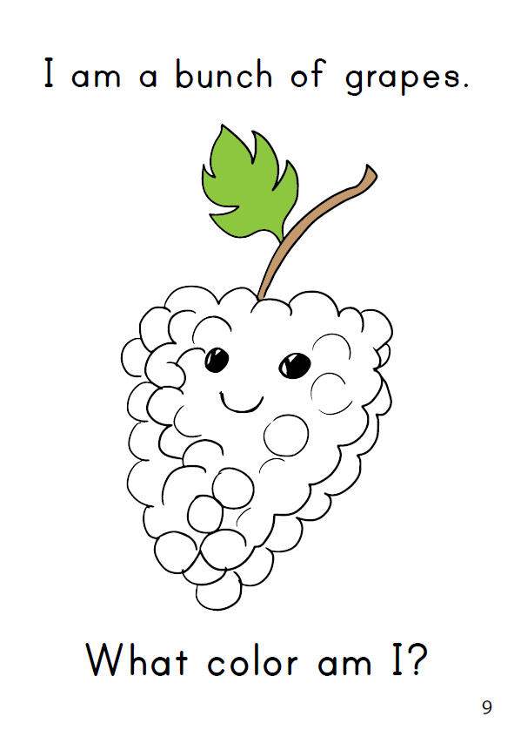
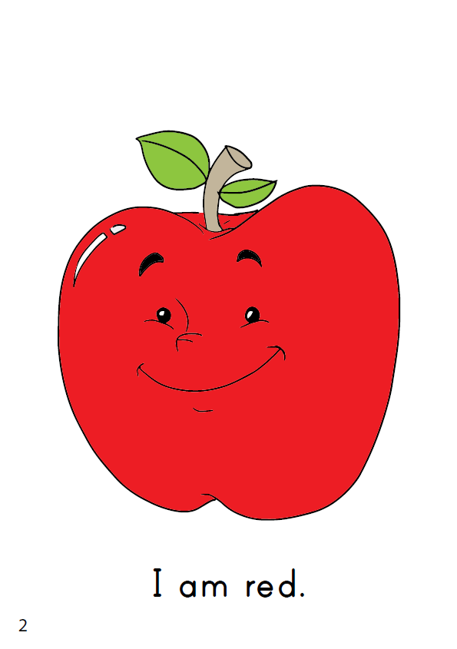
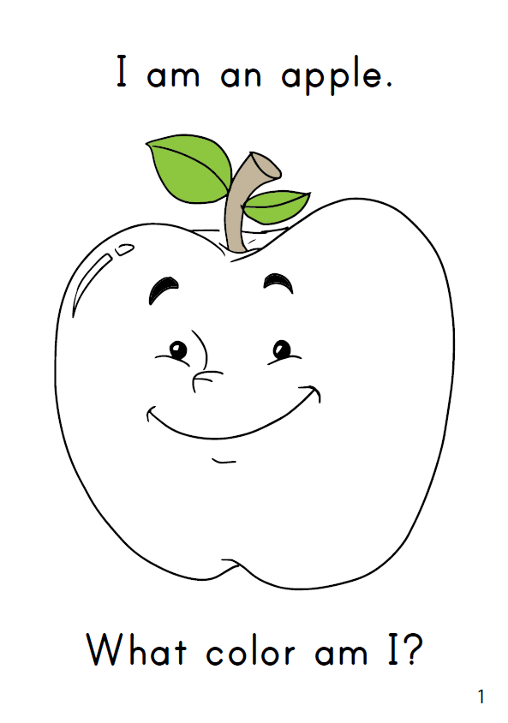
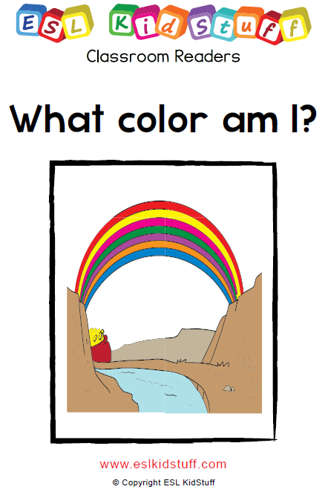

Read classroom reader "What color am I?"
Use either these slides or print out the reader booklet.
As you go through each page, point to the pictures and let your students shout out what color it should be:
Teacher: What is this? (pointing at the black and white apple on page 1)
Students: It's an apple!
Teacher: Yes, that's right! (reading from the story) "I am an apple. What color am I?"
Students: Red!
Teacher: Let's check ... (turning the page) ... Right! Good job! (reading from the story) ... "I am red". Can you point to something red in the classroom?
Students: (pointing to red things in the classroom)
… click panel for more »
Teacher: Yes, that's right! Red (books) and a red (T-shirt) ... (goes through all the red things students are point at).
Get the students really involved in the story by asking lots of questions (e.g. eliciting the objects and their colors) and getting everyone to point to colors in the classroom.
After reading the story, give out a reader worksheet to each student and read through the story one more time (without stopping for questions, etc.) as students color in the objects from the story. Check to make sure that everyone is using the correct colors.
… click panel to go back »
6
THE END
Press space or left click mouse to move to next slide.
Press left arrow key (◄ ) to go back through the book pages.
Song audio and video
only available to ESL KidStuff members.
Click here to remove message.
SAMPLE FOR EVALUATION
Join ESL KidStuff
to view without watermark.
To skip reader and jump to next slide, click here
Play reader video
Reader worksheet
Story time
[ Press space bar or left-mouse turn pages ]
[ Press space bar or left-mouse click to move to the next slide ]

Slide 22
Wrap up
SAMPLE FOR EVALUATION
Join ESL KidStuff
to view without watermark.
Assign homework: "Color the 6 fruit"
Say goodbye to glove puppet
Sing “The Goodbye Song"
Do "Quick check" and say goodbye
[ Press space bar or left-mouse click to move through the slides ]

Slide 23
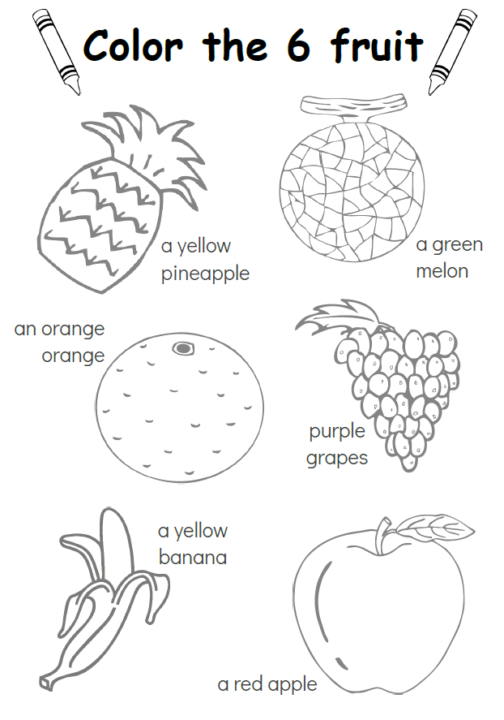
Assign homework: “Color the 6 fruit“
Hold up the homework worksheet and model coloring in the 6 fruit pictures.
Elicit each fruit and color as you go.
Give out the worksheets and say, "Put your homework in your bags" and help them to do so - this is important as they will probably want to start coloring them right away.
1
SAMPLE FOR EVALUATION
Join ESL KidStuff
to view without watermark.
Click to see
Homework
[ Press space bar or left-mouse click to move to the next slide ]

Slide 24
Say goodbye to glove puppet
Take out the bag again and get everyone to wake up the glove puppet by shouting its name into the bag (e.g. "Cookie Monster!").
Bring out the puppet and go through the same routine - go to each student and say hello, ask their name and the say goodbye / see you.
Then put the puppet back in the bag (back to sleep).
2
SAMPLE FOR EVALUATION
Join ESL KidStuff
to view without watermark.
Goodbye glove puppet
[ Press space bar or left-mouse click to move to the next slide ]

Slide 25
Sing The Goodbye Song
“The Goodbye Song" is a great way to sign off the class.
Sit together in a circle and sing and clap along.
Gestures
The first time you play the song do the gestures and encourage everyone to do them with you.
Wave as you sing the "Goodbye, goodbye" parts.
Hold your hand above your eyes (as you would when you are looking into the distance and keeping the sun out of your eyes) and look at another student as you sing "See you again".
Tap watch (or imaginary watch) and then point to the door as you sing "It’s time to go".
Point towards another student as you sing "See you next time".
The Goodbye Song
3
Song audio and video
only available to ESL KidStuff members.
Click here to remove message.
Song audio and video
only available to ESL KidStuff members.
Click here to remove message.
SAMPLE FOR EVALUATION
Join ESL KidStuff
to view without watermark.
Click to play song
Play song audio
Play song video

Slide 26
Do "Quick check" and say goodbye
Time to leave the class.
Make sure everything is put away and the students have gathered their belongings.
Have them line up at the door and place yourself between the door and the students.
For each student hold up a color or fruit and elicit what it is.
When they give you the correct answer say goodbye and let them leave. If their answer is wrong, have them go back to the end of the line - they will have to try again once they reach the front!
4
Goodbye!
SAMPLE FOR EVALUATION
Join ESL KidStuff
to view without watermark.
Goodbye and quick check
[ Press space bar or left-mouse click to move to the next slide ]

Slide 27

The end
Thank you!
SAMPLE FOR EVALUATION
Join ESL KidStuff
to view without watermark.
© Copyright ESL KidStuff
www.eslkidstuff.com

